Slide 1
1994: A Census Analysis
Caleb Pudvar

Slide 2
The Big Picture
Roughly 49,000 samples of personal data collected from the 1994 United States census
15 total attributes for each person
GOAL: determine factors that allowed a person to make more than $50,000 annually
$50,000 in 1994 = $76,000 in 2013

Slide 3
Attributes?
Age
Working class
Sex
Education
Occupation
Race
Native country
Family relationship
Capital gain
Capital loss
Hours per week
Marital status
Fnlwgt

Slide 4
Attributes?
Age
Working class
Sex
Education
Occupation
Race
Native country
Family relationship
Capital gain
Capital loss
Hours per week
Marital status
Fnlwgt

Slide 5
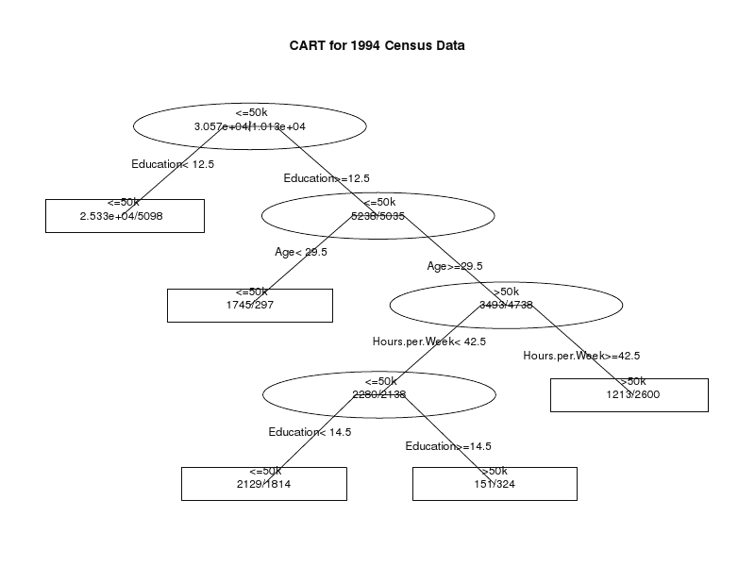
Preliminary Results
Constructed with 79.3% Correct

Slide 6
Initial Conclusions
Education of at least Bachelor’s degree has a huge impact on income
Around the age of 30, people with bachelor’s degrees tended to begin making more than 50k/yr
Working more than 42 hours per week further increased chances of making an income of 50k/yr

